Slide 1
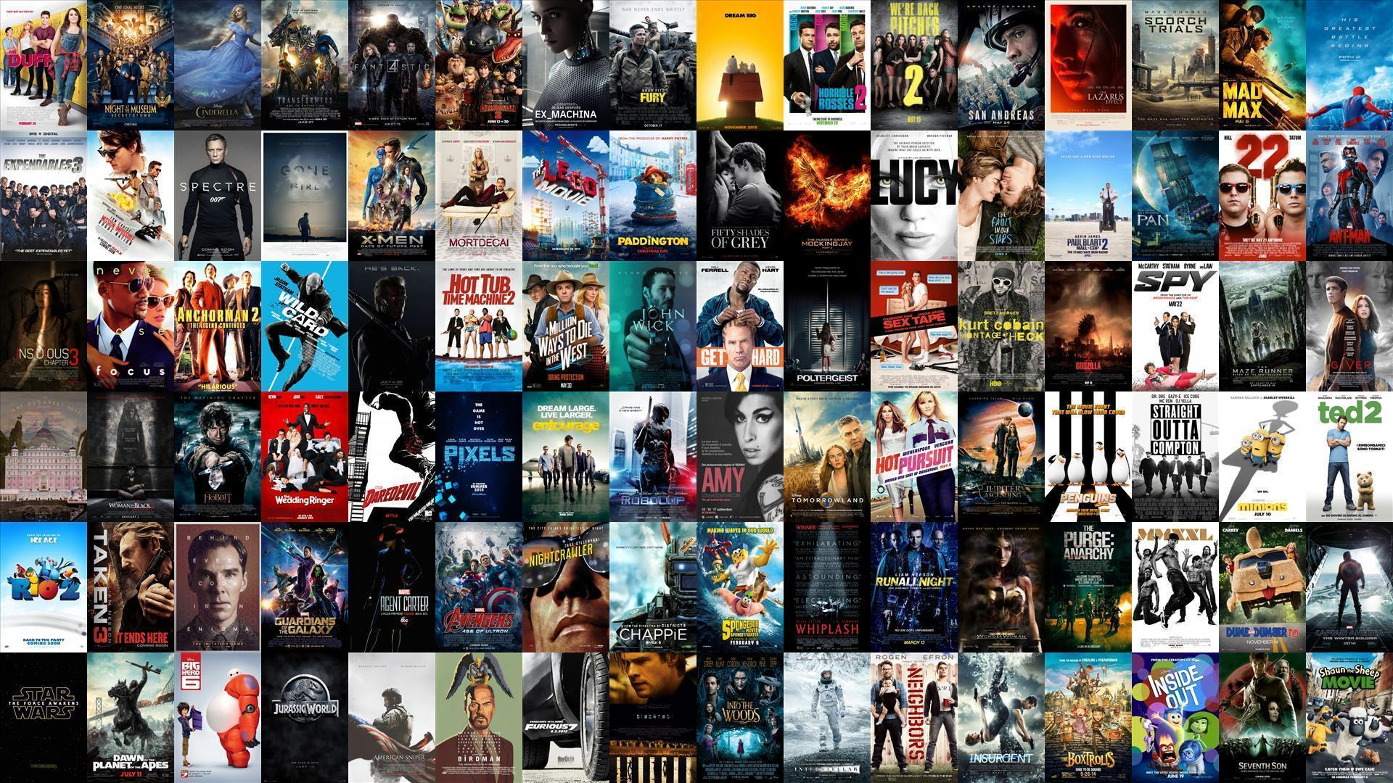
Sprint 1 - Moviender
Agile Methods for Data Science
Team: A3
11/14/2024

Slide 2

Product Vision
Have you ever been on a movie night but could not find the perfect movie?
So have we.
In order to save future dates from failure, we created:
Moviender

Slide 3

Product Vision (still)
Moviender is an easy-to-use website that always recommends the perfect movie for your occasion and preferences.

Slide 4
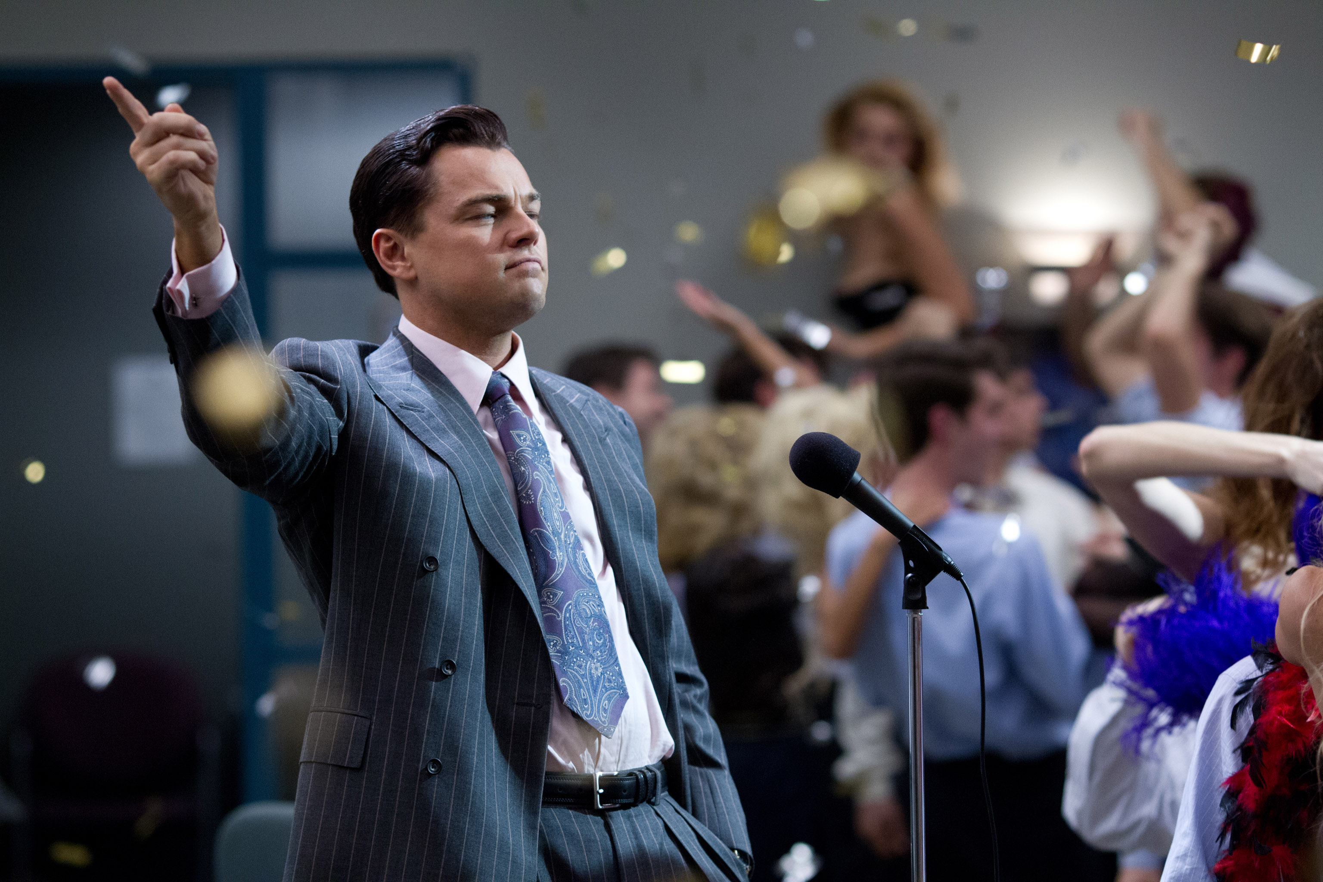
Theme (how to get rich)
different profiles:
basic: free, smaller models, previous predictions are not saved → less accurate predictions
premium: monthly subscription, best models, continuously retrained and personalised models → most accurate predictions
streaming deals:
connect our platform to streaming companies
advertise movies:
movies that pay are prioritised

Slide 5
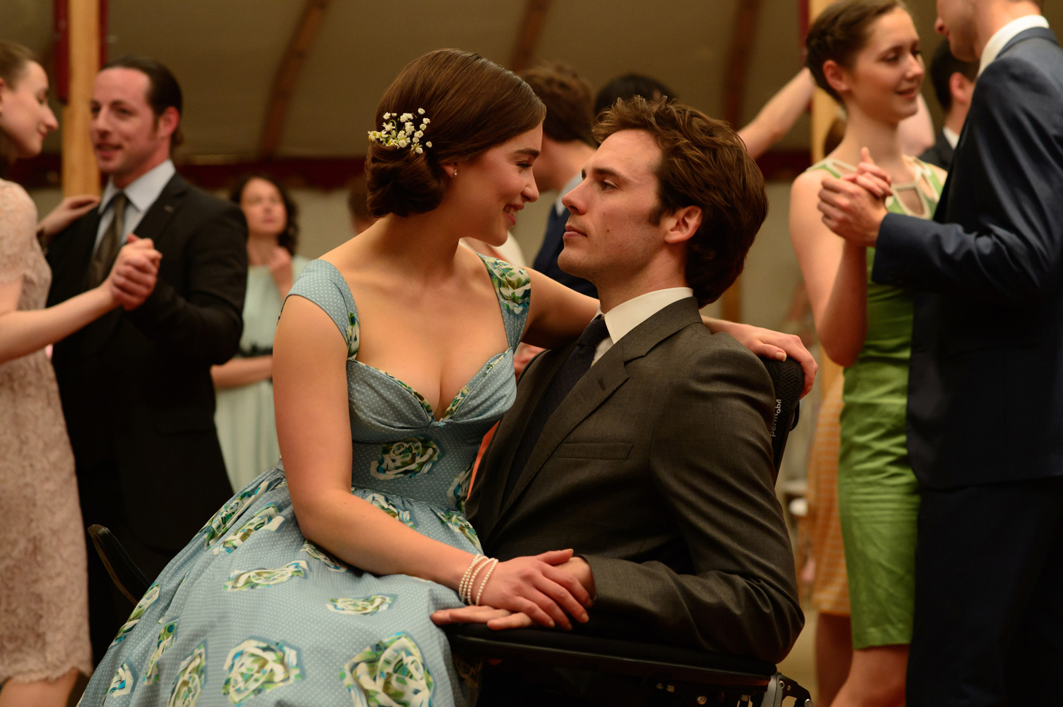
Epic – Tinder for movies
Moviender matches you with the best movies for your occasion and taste.
Interactively select the movies you like by swiping left or right on the movie profile.
Moviender finds the perfect match for you!

Slide 6
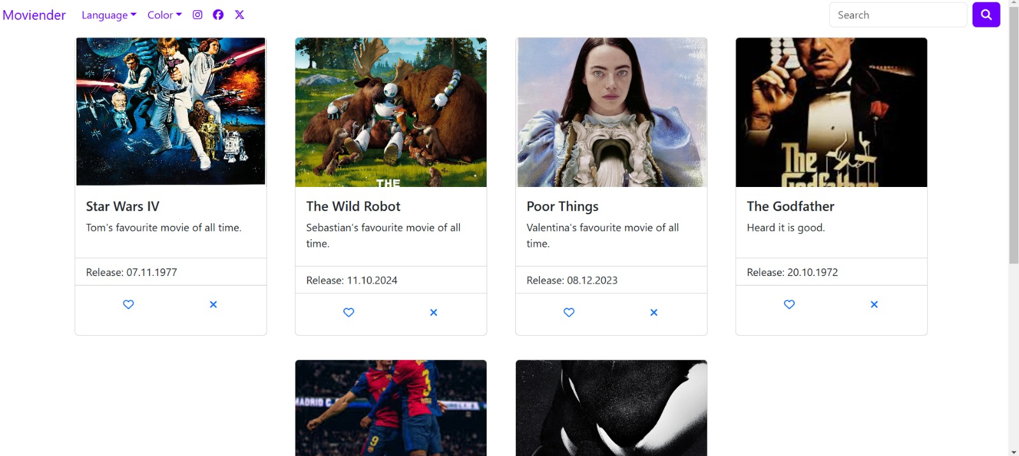
Website demo

Slide 7
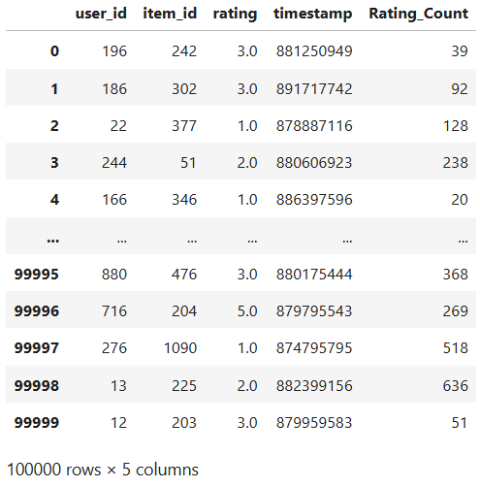
Model demo
Proposal:
Clustering model
Rank
Number of votes
Timestamp

Slide 8
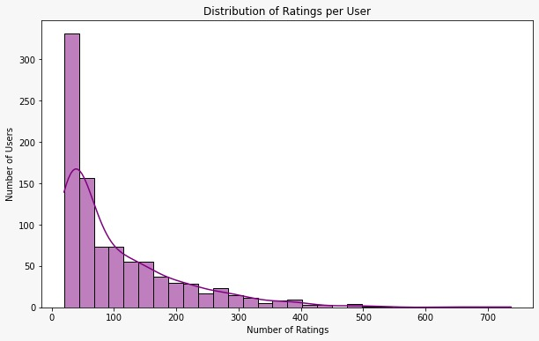
Model demo

Slide 9
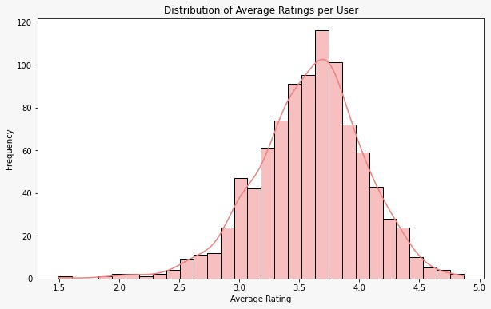
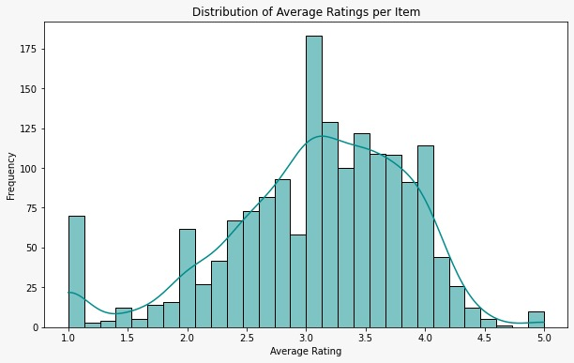
Model demo

Slide 10
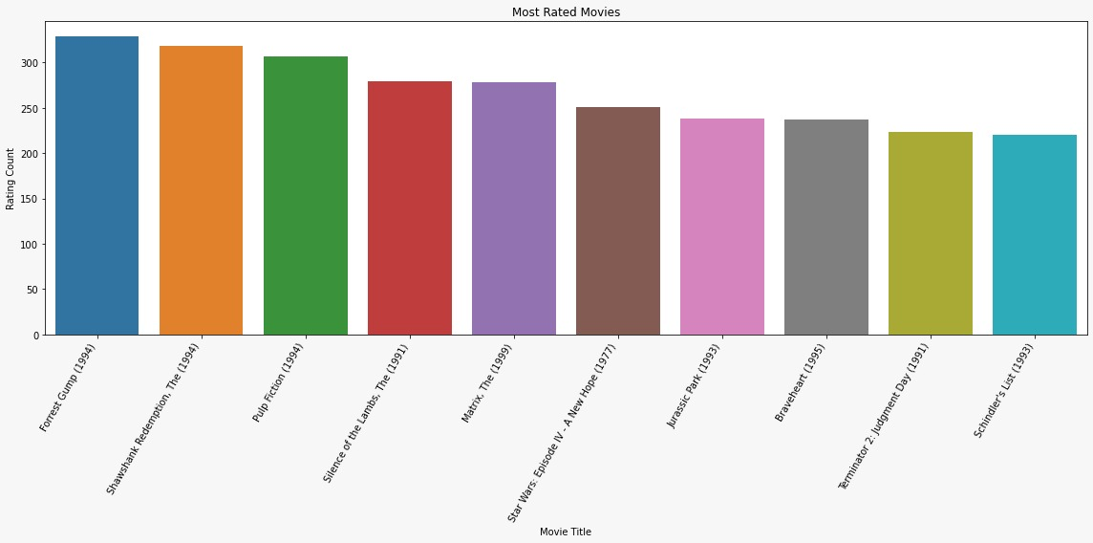
Model demo

Slide 11
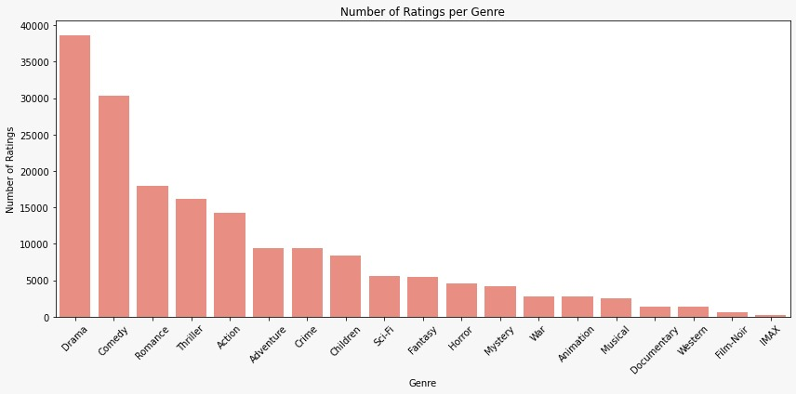
Model demo

Slide 12
Let‘s revolutionise movie nights together! Moviender

